Slide 1
Surgical Methods of uterine evacuation
Year 4 MB,ChB

Slide 2
Objectives
Describe methods for evacuating the uterus.
Explain the rationale for replacing sharp curettage (SC) with vacuum aspiration

Slide 3
MVA for Uterine Evacuation
women will require uterine evacuation at some time in their lives.
Χομμονεστ ινδιχατιον ισ ινχομπλετε αβορτιον
World Health Organization (WHO) recommends Vacuum aspiration as the preferred method.

Slide 4
Pain Management During MVA
Women’s responses to pain vary.
Goal: reduce pain and anxiety, minimize risk.

Slide 5
Factors to Consider
The woman’s wants and needs
Her medical history and physical and psychological status
Psychological concerns and potential anxiety

Slide 6
Interaction with the patient
Explain the procedure.
Discuss about the pain she may experience.
Explain risks, benefits, alternatives to each pain management option.
Allow her to assist in selecting the interventions.

Slide 7
Three Sources of Pain During MVA
Psychological pain: anxiety, fear, apprehension
Cervical pain due to dilatation
Uterine cramping due to manipulation

Slide 8
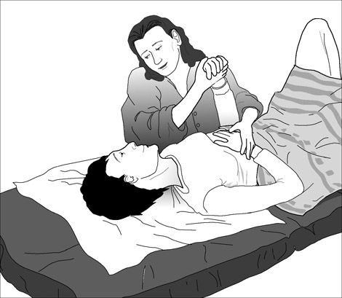
Provide Verbal Reassurance

Slide 9
Non-Pharmacological Methods for Relieving Psychological Pain
Gentle, respectful interaction and communication
Verbal support and reassurance
Gentle, smooth operative technique
Can supplement but not replace medications

Slide 10
Pharmacological Means of Addressing Psychological Pain
Anxiolytics/sedatives relieve anxiety.
Analgesics relieve pain.
General anesthesia should be reserved for extreme cases.

Slide 11
Steps of the MVA Procedure
  1. Prepare instruments.
  2. Prepare the woman.
  3. Perform cervical antiseptic prep.
  4. Administer paracervical block.
  5. Dilate cervix.

Slide 12
Steps of the MVA Procedure (cont.)
    6. Insert cannula.
    7. Suction uterine contents.
    8. Inspect tissue.
    Perform any concurrent procedures.
    Process instruments.

Slide 13
Selection of Cannulae
Depends on uterine size and amount of dilation:
  Uterine size 4–6 weeks LMP:
  suggest 4–7mm
  Uterine size 7–9 weeks LMP:
  suggest 5–10mm
  Uterine size 9–12 weeks LMP:
  suggest 8–12mm

Slide 14
Step 1: Prepare Instruments
Check that the aspirator retains a vacuum.
Have more than one aspirator available.

Slide 15
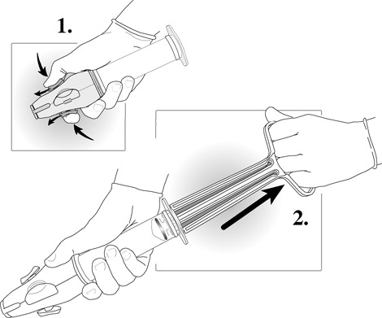
Create a Vacuum

Slide 16
Step 2: Prepare the Woman
Ensure pain medication is given at the appropriate time.
Ask the woman to empty her bladder.
Ask for her permission to start.
Perform a bimanual exam.

Slide 17
Step 3: Perform Cervical Antiseptic Prep
Follow No-Touch Technique.
Use antiseptic sponges to clean cervical os, cervix and, if desired, vaginal walls.
Do not retrace areas previously cleaned.

Slide 18
Step 4: Administer Paracervical Block
Recommended for all MVA procedures.
Injection sites vary but technique accepted globally.
Usually 10–20mL of 0.5%–1.0% lidocaine (always less than 200mg).
Always aspirate needle before injecting.

Slide 19
Step 5: Dilate Cervix
Dilatation usually is not required in most cases.
Cannula should fit snugly in the os to hold vacuum.
Use gentle operative technique.

Slide 20
Step 6: Insert Cannula
Gently apply traction to the cervix.
Rotate the cannula while gently applying pressure.
Insert cannula slowly until it touches the fundus, then draw it back.

Slide 21
Step 7: Suction Uterine Contents
Attach charged aspirator to cannula.
Release buttons to start suction.
Gently rotate cannula 180 degrees in each direction.
Use a gentle “in and out” motion.
Do not withdraw cannula opening beyond external os.

Slide 22
Step 8: Inspect Tissue
Empty contents of aspirator into container.
Look for POC; villi and decidua should be visible.
It is important since you may have a molar pregnancy

Slide 23
Step 10: Process Instruments
Process or discard instruments immediately.

Slide 24
Step 9
Clean the cervix
Do bimanual examination
Check for any significant bleeding

Slide 25
Women With Complications
Some women present for abortion care with complications.
Some women experience complications during abortion care.
Other women experience complications after abortion care.

Slide 26
ELECTRICAL VACUUM ASPIRATION

Slide 27
EVA
The principle is the same as in MVA
Electrical vacuum aspiration is used
Many clinicians prefer it to MVA if in theatre

Slide 28
DILATATION AND EVACUATION (D&E)

Slide 29
Uterine Evacuation Methods
Uterine evacuation removes contents of the uterus.
There are several methods for providing first-trimester uterine evacuation:
  Vacuum aspiration techniques
  Medication (or pharmacological) techniques
  Sharp curettage (SC)

Slide 30
SC
You may need to dilate the cervix serially
Use of metallic sharp curettage instruments
Disadvantage is that it is under GA, thus has increased risks
It has increased risks of perforations
MVA is therefore preferred

Slide 31
Thank you

